Slide 1
Welcome to
NCAA Eligibility Center:
Core Course Updates
Presented by the National Association for College Admission Counseling
March 9, 2011

Slide 2
Matt Drake: Assistant Director of Education and Training, NACAC (VA)
Presenters
Lisa Mills: Director of High School Review, NCAA Eligibility Center (IN)
Nick Sproull: Assistant Director of High School Review, NCAA Eligibility Center (IN)
Moderator
2

Slide 3
Join NACAC Today! Begin Enjoying Your NACAC Membership Experience…
Endless networking and career connections that will build your professional support system
A vast body of knowledge that will advance your work and keep you in touch
Essential training and professional development tailored to give you techniques and tips
Opportunities for involvement and recognition that provide you with a respected leadership forum
Unity in mission and vision to make a powerful impact for you and your students
3

Slide 4
Join us May 31 – June 3 for Critical Components
Topics include:
Financial Literacy
Working with LGBTQ students during the college search process
Managing large secondary school caseloads
The ins and outs of for-profit colleges
Looking inside the committee room with deans of admission
For more information or to register, visit www.nacacnet.org/critical
4

Slide 5
Join us for these upcoming Webinars
March 23: Help Wanted: Projections of Jobs and Education Requirements through 2018 April 13: Launching Recruitment Efforts in China April 27: Key Issues in the Summer Transition from High School to College
To register for any of NACAC’s 2011 Webinars or to view archived webcasts, visit www.nacacnet.org/webinars
5

Slide 6
Game Plan
Overview of the NCAA
Why the NCAA Eligibility Center?
Initial-Eligibility Requirements
Core Courses
News and Trends
6

Slide 7
Poll Question
Please select the answer that best describes you:
7

Slide 8
Quick Overview
Organization of the NCAA
Division I
Typically large study body size
Athletic grants-in-aid available
Division II
Typically small to medium sized schools, smaller athletic budgets
Athletic grants-in-aid available
Division III
Largest of the three divisions, typically small student bodies
Athletic grants-in-aid not available
8

Slide 9
Quick Overview
 | Division I | Division II | Division III
Number of Member Institutions | 323 | 283 | 424
Average Undergraduate Enrollment | 10,054 | 3,306 | 2,146
Total Operating Expenses for Athletics | $23.2M (I-A), $6.8M (I-AA) | $2.3M (football) $1.5M (no football) | $1.25M (football) $.66M (no football)
Average Expense per Athlete | $42,000 | $8,000 | $3,000
9

Slide 10
Transition to the Eligibility Center
Why the Eligibility Center?
All initial eligibility functions under one roof
Domestic and international certification
Academic certification
Amateurism certification
High school review
Core-course review
Customer Service
National Letter of Intent (NLI)
10
Notes:
# of FTE’s: 58. Almost half of our staff holds an advanced degree or is working toward one.
8 JD’s
10 Master’s (3 MBA’s)
5 Master’s in Progress
1 PhD
2 Doctoral candidates

Slide 11
Transition to the Eligibility Center
Did you know?
Approximately 30,000 high schools
Approximately 600 Division I and II institutions
Approximately 500,000 pieces of mail throughout the year
From June to September, the EC will evaluate 78,000 final cases and 31,000 preliminary cases
From October to May the EC will evaluate 50,000 preliminary cases and 6,000 final cases
In all, throughout the year, the staff will conduct 165,000 evaluations - this includes reviewing some cases more than once (One-time “customers”)
11

Slide 12
Poll Question
How familiar are you with the initial eligibility requirements?
12

Slide 13
Initial-Eligibility Overview: Academics
NCAA Division I Academic Requirements
In order to compete as a freshman, an athlete must:
Graduate from high school; and
Earn a minimum required GPA in a prescribed distribution of 16 approved core courses; and
Earn a combined SAT or ACT sum score that matches the core-course GPA (refer to the “sliding scale” in the NCAA Guide for the College-Bound Student-Athlete).
13

Slide 14
Initial-Eligibility Overview: Academics
NCAA Division II Academic Requirements
In order to compete as a freshman, an athlete must:
Graduate from high school; and
Earn at least a 2.0 GPA in a prescribed distribution of 14 core courses; and
Earn a combined SAT score of at least 820 (Critical Reading + Math) or an ACT sum score of at least 68.
No sliding scale for Division II
14

Slide 15
Initial-Eligibility Overview: Academics
NCAA Division III Academic Requirements
Unlike Divisions I and II, there is no uniform set of eligibility requirements for Division III schools
Eligibility for admission, financial aid, practice and competition is determined by institutional regulations
The academic standards at most Division III colleges far surpass the minimum requirements for Division I or II competition
15

Slide 16
Initial-Eligibility Overview: Academics
Division I:
16 Core Courses
4 years English
3 years math (Algebra I or higher)
2 years natural/physical science
1 year additional English, math or natural/physical science
2 years social science
4 years additional courses
Division II:
14 Core Courses
3 years English
2 years math (Algebra I or higher)
2 years natural/physical science
2 years additional English, math or natural/physical science
3 years 2013 and after
2 years social science
3 years additional courses
4 years 2013 and after
16

Slide 17
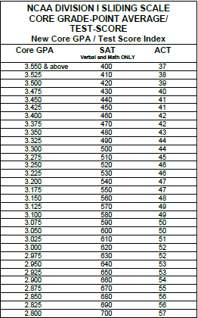
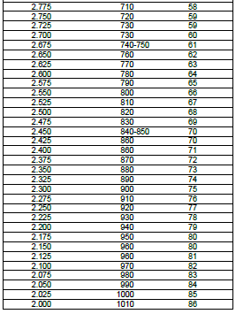
Initial-Eligibility Overview: Academics
17

Slide 18
Definition of a Core Course
Qualifies for high school graduation in one or more of the following: English, mathematics, natural or physical science, social science, foreign language or comparative religion or philosophy;
Is considered academic, four-year college preparatory;
Is taught at or above the high school's regular academic level;
For mathematics courses, is at the level of Algebra I or a higher level mathematics course; and
Is taught by a qualified instructor as defined by the appropriate academic authority
18

Slide 19
Courses for Students with Education-Impacting Disabilities
Course must be qualitatively and quantitatively the same as an already-approved equivalent course
Course must be exclusively for students with documented education-impacting disabilities
Curriculum must be the same among students in the class
19

Slide 20
Eighth Grade Courses
NCAA legislation prohibits the use of eighth grade courses; high school courses taught in the eighth grade may be acceptable.
Must receive graduation credit;
Must be on high school transcript with grade and credit; and
Must be on NCAA’s List of Approved Core Courses
20

Slide 21
Core Course Quiz 1
On title alone, what decision would you give the course “Literature and Film Study”?
21

Slide 22
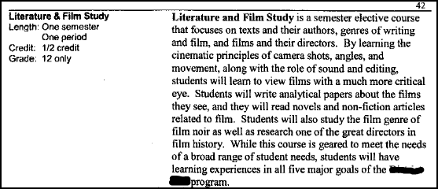
Core Course Quiz 2
22

Slide 23
Liberal Arts Mathematics Prerequisites: Algebra 1 and Geometry The purpose of this course is to enable students to strengthen algebraic and geometric concepts and skills necessary for further study of mathematics. The content should include, but not be limited to, the following: exponents and radicals, algebraic expressions and polynomials, equations (linear and quadratic) and inequalities, coordinate geometry, functions, relations, and graphs, systems of linear equations and inequalities, properties of two- and three-dimensional figures, geometric relationships, and basic concepts of data analysis and probability. Note: This course does not meet the academic core requirement in mathematics for entry into the State University System or eligibility requirements for the state scholarship program.
Core Course Quiz 3
23

Slide 24
Environmental Science Accelerated [1/2 credit] Prerequisites: departmental approval Environmental Science is designed to be an interdisciplinary science course that provides the student with a look into the complex systems of earth and how humans fit into these complex processes. The course will not only draw from biology, chemistry and physics, but also a variety of other disciplines including history, anthropology, sociology, political science and law. The course will also provide insights into the variety of professional opportunities in this growing field. Topics will include ecology, energy resources, pollution, resource recovery, and environmental policy.
Core Course Quiz 4
24

Slide 25
Core Course Quiz 5
25

Slide 26
Core Course Time Limitation Division I
If students do not graduate "on time" in eight semesters, any core courses taken after the eighth semester will not be counted toward NCAA academic-eligibility requirements.
“On time” means that students have four years (eight semesters), based on when students start grade nine (freshman year)
Students who DO graduate on time may use one course toward their initial eligibility
Students with education-impacting disabilities who graduate on time may use three courses toward their initial eligibility
26

Slide 27
Early Certification Waiver
Students who meet the following criteria after six semesters will be certified as qualifiers:
Minimum SAT (Math and Critical Reading) of 1000 or minimum sum score of 85 on the ACT; and
For Division I: Core-course GPA of 3.0 or higher in a minimum of 13 core courses:
3 English
2 Math
2 Science
6 additional core courses
For Division II: Core-course GPA of 3.0 or higher in a minimum of 12 core courses:
3 English
2 Math
2 Science
5 additional core courses
27

Slide 28
News and Trends
High School Portal
Nontraditional Courses
Legislation
Transcripts and Grade Reports
28

Slide 29
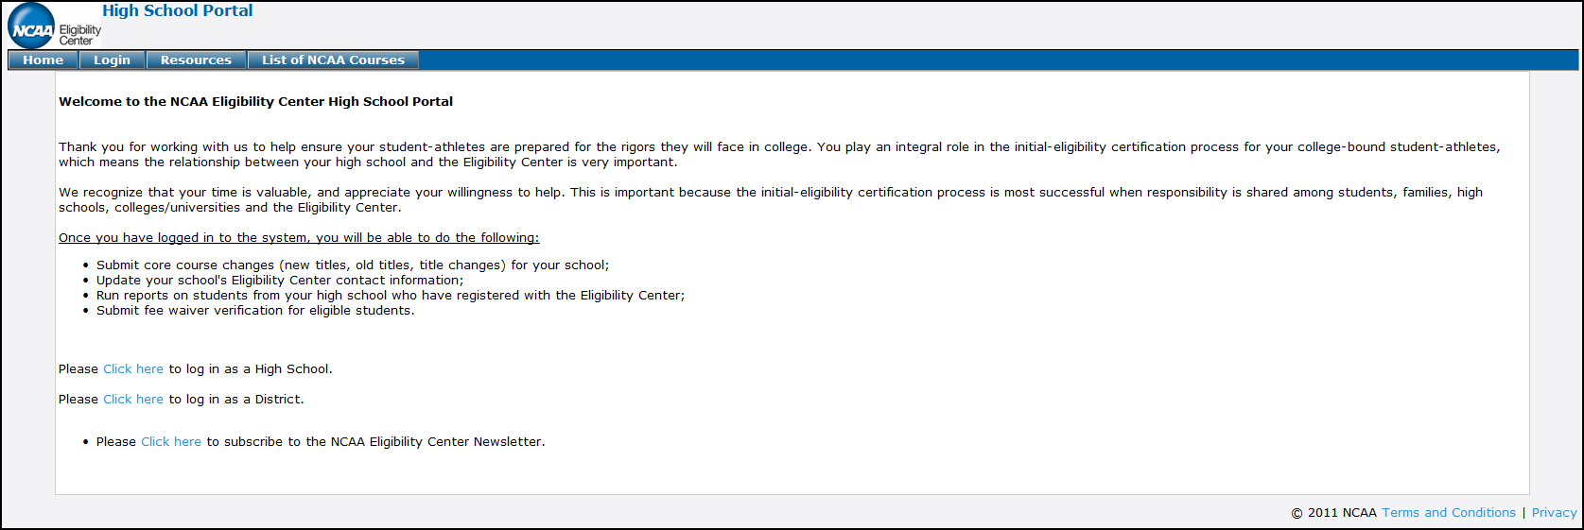
High School Portal
29

Slide 30
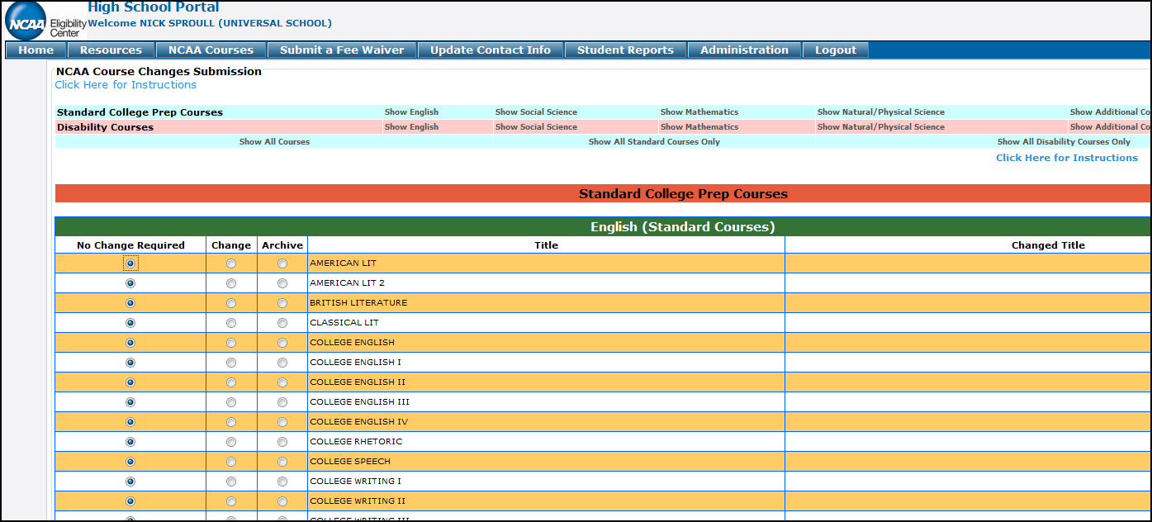
High School Portal
30

Slide 31
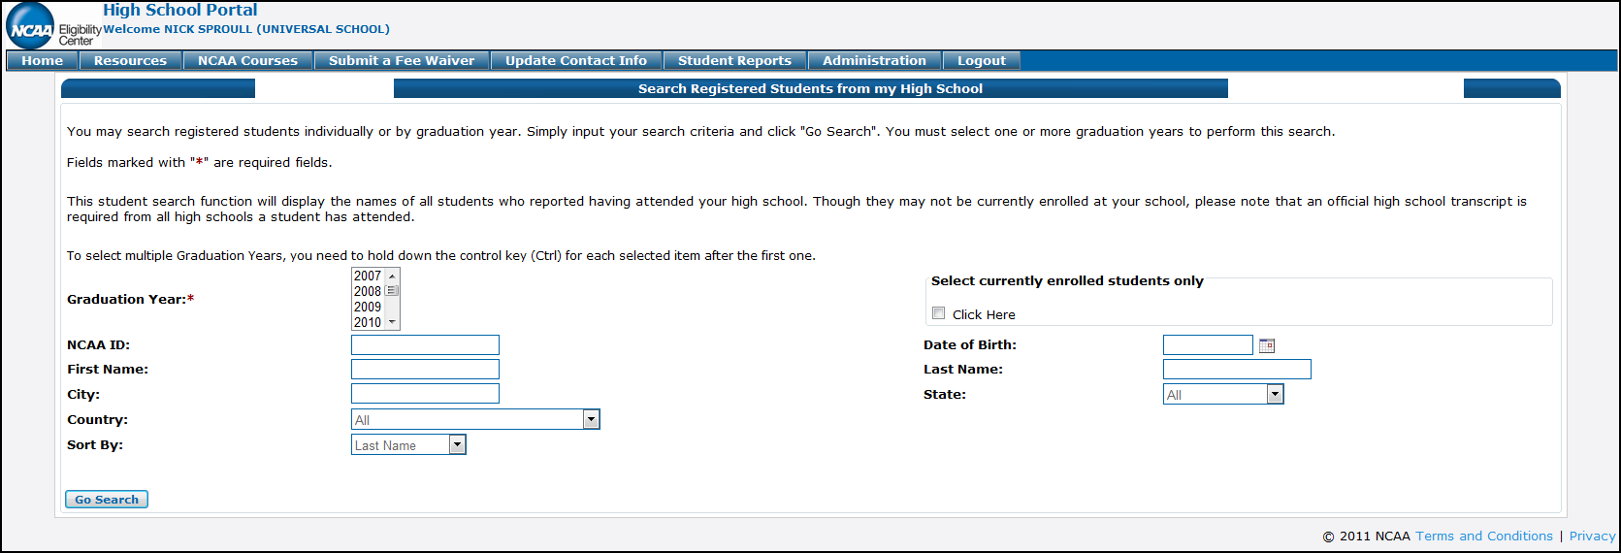
High School Portal
31

Slide 32
Nontraditional Courses
Types
Online and Virtual Schools
Nontraditional courses in traditional schools
Credit recovery and Grade recovery
Transparency on transcripts is essential
32

Slide 33
Poll Question
Does your school offer nontraditional courses?
33

Slide 34
Nontraditional Courses
Nontraditional Core Course Legislation
Must meet definition of a core course.
Student/Instructor Interaction
Timeframe
34

Slide 35
Role of the High School
Make sure your school’s NCAA List of Approved Core Courses is accurate and up to date.
Send 6th semester transcripts and 8th semester transcripts for students who have registered with the Eligibility Center at the end of each academic year.
Submit fee waivers for student registration when applicable.
35

Slide 36
Ways That You Can Help
Know the initial-eligibility requirements.
Use resources to map out the academic track.
Know how to calculate a student’s core-course GPA.
Know that special considerations are given to students with documented education-impacting disabilities.
Create an efficient system to process Eligibility Center applications (including submission of an official transcript at the end of the junior and senior years).
36

Slide 37
Ways That You Can Help
Emphasize the importance of academic performance at every step of the prospective student-athlete’s high school career. Grade nine counts!
CALL US! 877/622-2321 (877/NCAA-EC1)
37

Slide 38
Ways That You Can Help
E-transcripts may be received from the following:
Docufide
e-Scrip Safe
ConnectEDU
National Transcript Center
XAP
38

Slide 39
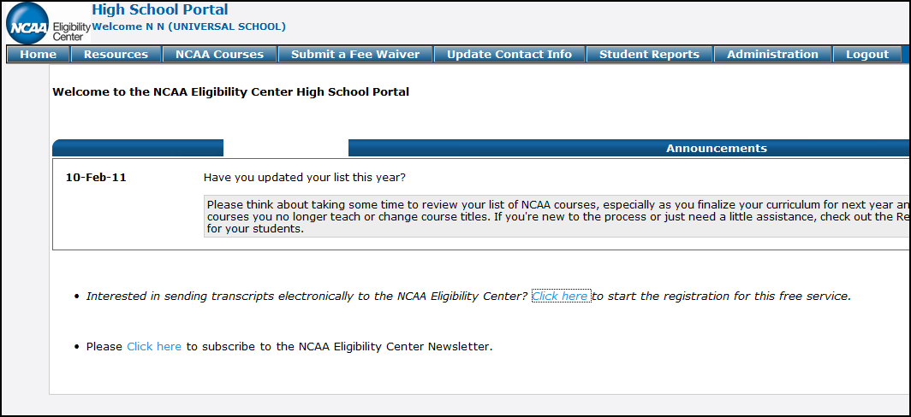
Docufide
E-Transcripts
39

Slide 40
Questions?
Phone line dedicated to the high school community: 877/622-2321 (877/NCAA-EC1)
40

Slide 41
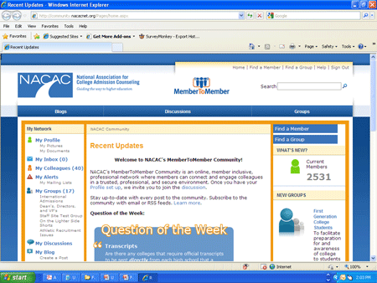
Remember: NACAC Members Can Join us in the Community
We will continue this discussion in the
NACAC MemberToMember community!
41

