Slide 1
College Search I
College is a match to be made, not a prize to be won.
Thursday, November 5, 2015
SWHS Counseling Department

Slide 2
Agenda
Starting the College Search
College Admissions Testing
Intro to College Admissions
Timeline
Notes:
GM- Intro & Agenda
KVP-College Search
JM- Testing
DJ-Intro Admissions
JV- Timeline & Wrap Up

Slide 3
Starting the College Search

Slide 4
Step 1: Interests & Preferences
Determine interests & preferences
Academic
(large classes vs. small groups; competitive environment vs. collaborative; discussion based vs. lecture; research opportunities, theory vs. application)
Personal/Social
(religious affiliation; Greek system; athletic opportunities; artistic opportunities)
Location
(urban vs. small town; proximity to family; proximity to urban centers; proximity to outdoors)
Prioritize in order of importance to you

Slide 5
Student & Parent Preferences May Be Different
College Feature | Student Preference | Parent Preference
Academic | Large lecture classes. “Less noticeable if I sleep in and miss class.” | Large lecture classes. “May mean cheaper tuition…”
Location | Far from home. “Freedom!” | Close to home. “Not too much freedom…”
Cost | Not important. “$5,000? $50,000? What’s the difference” | Absolutely important. “That’s the tuition PER YEAR?”

Slide 6
Step 2: Explore & Gather Information
Online research
Naviance
Princeton Review
College Niche
CollegeBoard
“Hit the Streets”
Campus Tours
Project Success Tours
At Southwest
Licensed School Counselors
AchieveMpls Career & College Center (CCC)
College representative visits
Naviance
Reflect & Update
Priorities
Explore College
Options

Slide 7
Step 3: Start & Keep a List
Keep a running list
School name and WHY interesting
Start broad OR Start small
Lots of interest? Add them all, then sort out as you get more information
Have a top choice school? Find similar options to expand the list
Plan for first degree
Consider end goal, first degree first
Cost: Don’t rule out at this point
Be aware, but consider all options
Use FAFSA estimators, Net Price Calculators
Initial Search: 15-25 colleges
By end of Summer:6-9 colleges

Slide 8
Tips for Success
THE perfect school = myth
Invest the time now
Senior year will be busy with applications
You are the consumer
Shop for a good fit for you, for now
Ideals
Standards
Belief
Budget
Abilities

Slide 9
Other things to consider…
% that graduate in 4-5 years
Retention Rates (how many students choose to stay)
Diversity of student body
Graduate school placement rates
“Brand” names, “good” schools, and influence of friends
Scholarship opportunities from colleges*
Academic (merit-based)
Need-based
Likelihood of Admission (Safety/Target/Reach)*
*Be careful of ruling out colleges you’re highly interested in for these reasons alone. Admissibility and Financial Aid should be considered in your search, but you won’t know definitively until you have applied.

Slide 10
College Admissions Tests
No child left untested

Slide 11
College Admission Tests: ACT & SAT
Offered during 6-7 Saturday test dates each year
Register online,
Typically +1 month before test date
Select test date & test location at registration
Southwest is NOT a Saturday testing location
Encouraged to select 4 college to receive test scores
During registration/before test= 4 for free
After test= $12/college
Registration Fee required (~$53)
2 Registration Fee waivers for Free/Reduced Lunch

Slide 12
To Send or Not To Send? No Question
Always send scores (for ACT & SAT)
Colleges ALWAYS use scores to students’ advantage
Highest score always used
Superscore
Lets colleges know student is interested
Able to send scores to 4 colleges at no cost prior to test date
$12/test date/college to send after test date

Slide 13
College Admission Tests: ACT vs. SAT
All colleges accept either/both tests
Prefer to see whichever test student performs better on
ACT/SAT score concordance
Chose ACT or SAT; pursuing both is too much
Look at PLAN/PSAT scores to determine stronger test
PLAN=Pre-ACT, 10th grade
PSAT=Pre-SAT, 10th and/or 11th grade
Take practice tests on Naviance to determine stronger test
Prepare, test, retest as needed in stronger test (not both)

Slide 14
College Admission Tests: ACT vs. SAT
ACT= content-based test
Students often find more straightforward
Familiar with format from EXPLORE, PLAN
SAT= aptitude/reasoning test
May benefit stronger standardized test takers
Students self-select to “practice” with the PSAT (may or may not be a familiar format)

Slide 15
College Admission Tests: ACT vs. SAT
SAT= New starting March 2016
Return to 1600 scoring scale
No longer penalized ¼ point for wrong answers
Different format for questions
Different timing
March scores not back to students until May
New test → No baseline/experience with new test yet

Slide 16
Test Optional and Test Flexible
www.fairtest.org
A group of schools that do not require tests to be considered for admission
Nearly 850 schools
Check for how schools use test scores
Placement in courses vs. admission
Required for scholarship from school or community?
Community colleges
Do not require ACT/SAT
may use ACT/SAT scores or Accuplacer for course placement

Slide 17
Test Prep Options
PrepMe
Naviance home page
Click on “PrepMe” (ACT, SAT, & PSAT prep)
Small Group or Class
ACT Ready
MPS Community Education
Individual tutoring
Huntington
Princeton Review
College Nannies & Tutors
Books
Tips:
Prep leading up to a specific test date (5-6 weeks ahead)
Prep vs. Obsession
3.5 hours on Saturday vs. 3 years on transcript

Slide 18
Preliminary ACT Tuesday, November 17th at Southwest
A retired, full-length ACT with Writing
Gives students a score to use for reference, prep before taking an official ACT later this year
Provides SW staff trend data in order to supplement classroom instruction
Administered in 2013 & 2014, 92% & 94% of juniors participated
NOT an official score for college applications
Additional information has been sent via email
Can also be found on SW Counseling Website: Nov 17

Slide 19
District-Wide ACT Tuesday, March 15 at Southwest
District paying for ALL juniors to take ACT with Writing
Juniors will register in class at Southwest prior to March 15th (do not need to register outside of school)
March 15th ACT with Writing fully covers the Grad Testing Requirement for Class of 2017
Official score, can be used for college applications and scholarships
Test prep options for March ACT at SW to be announced
Watch your email!

Slide 20
Planning for Testing
Most students take test 2-3 times
1st test: late winter/spring of junior year
2nd test: spring/summer of junior year
3rd test: fall senior year
Consider finals and any AP/IB testing in May
A Recommended Testing Schedule:
Dec - Feb : Choose ACT or SAT
Jan- April: Take 1st Official ACT or SAT
-remember March 15th ACT @ SW (regardless of ACT or SAT choice)
May-June: --AP/IB Tests and Finals at Southwest –
June: Take 2nd Official ACT or SAT
Oct: Take 3rd Official ACT or SAT
-before college admission deadlines

Slide 21
Intro to College Admissions
More to come…

Slide 22
Office of Admission
What they do:
Office of Admission, not Denial
Responsible for finding, admitting, and enrolling a strong freshmen class (must meet admin’s goals)
Looking to craft the most well-rounded, active class possible
Want to enroll students who will be successful and who will contribute to their campus
How they do it:
Criteria used to determine admissions decisions
Primary Factors (tonight)
Secondary Factors (in Spring, College Search II)

Slide 23
Primary Admission Factors:
Grade Point Average (GPA)
Test Scores (ACT or SAT)
Class Rank
Account for 60-65% of admission decision
Concrete comparables
Comprise a student’s “Profile”

Slide 24
Secondary Admission Factors:
Extracurricular Activities &Leadership
Essay or Personal Statements
Letters of Recommendation
Account for 30-35% of admission decision
Holistic Review of applicant
Can make a strong applicant stronger
primary factors must put the student in the running before secondary factors can be considered
*Focus of College Search II presentation in Spring 2016

Slide 25
Comparing Your Profile: Likelihood of Admissions at Specific Colleges
Likely: Likely/Realistic
Your Profile is SIGNIFICANTLY stronger than the typical freshmen
60-90% chance of admission
Target: Selective/Reasonable
Your Profile is SIMILAR to the typical freshmen
30-60% chance of admission
Reach: Most Selective/Difficult
Your Profile NOT as strong as typical freshmen
Less than 30% chance of admission

Slide 26
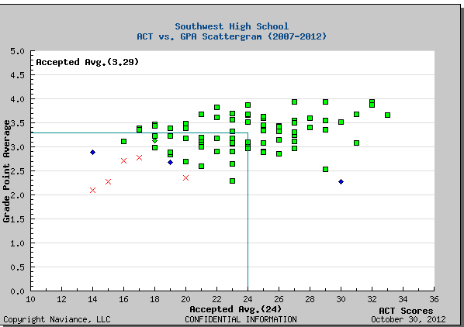
Using Scattergrams to Compare Profile

Slide 27
Using Scattergrams to Compare Profile
Likely
Target
Reach

Slide 28
Using Scattergrams to Compare Profile
Likely
Target
Reach
= Student w/ 23 ACT and 3.6 GPA

Slide 29
Going deeper
Common Data Set (CDS)
“The CDS initiative is a collaborate effort among data providers in the higher education community and publishers as represented by the College Board, Peterson’s, and U.S. News & World Report…. The combined goal of this collaboration is to improve the quality and accuracy of information provided to all involved in a student's transition into higher education.”
From www.commondataset.org
Enrollment & Persistence, Freshmen Admissions, Academic Offerings, Financial Aid, and more

Slide 30
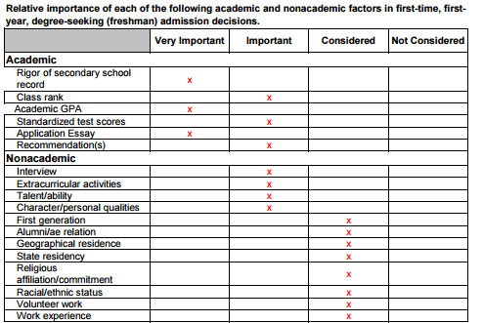
Going deeper: CDS
Example #1: St. Olaf College 2014-15
From St. Olaf Website: wp.stolaf.edu/ir-e/common-data-set, Nov 4, 2015

Slide 31
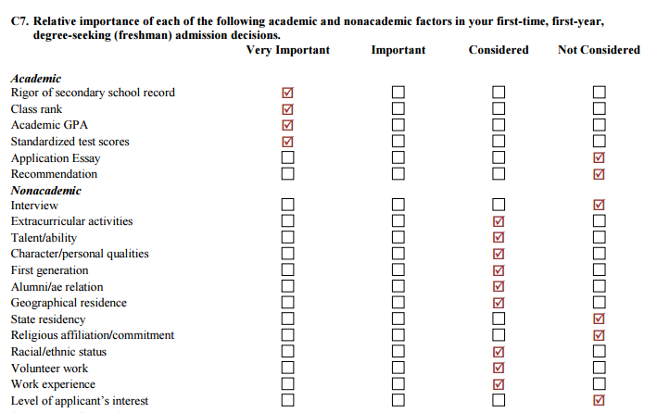
Going deeper: CDS
Example #2: University of MN- Twin Cities 2014-15
From UMN Website: www.oir.umn.edu/static/stsur/cds, Nov 4, 2015

Slide 32
Southwest’s College Trends
General Trends
Class of 2015
4-yr college/university | 68% | These results are typical of SW graduates
2-year community/tech college | 22%
Classes 2008-2014
4-yr college/university | 69%
2-year community/tech college | 21%
Applications | Matriculations
U of MN—Twin Cities | U of MN—Twin Cities
UW-Madison | MCTC/Normandale
U of MN--Duluth | UW-Madison

Slide 33
Timeline Ahead
Wrapping it up…

Slide 34
Timeline: Fall/Winter
Parents
Students
Get Naviance access
Rank priorities
Begin conversation about cost
Assist with scholarship search
Self search
Rank priorities
Plan for testing & register
Considering AP/IB testing
Scholarship search
Continue to work hard in school; meet with counselor as needed
Register NCAA Clearinghouse if DI or DII athlete

Slide 35
Timeline: Spring/Summer
Parents
Students
FAFSA4caster
Net Price Calculators
Assist with student’s scholarship search
Complete Senior Parent/Guardian Recommendation in Naviance
Take ACT/SAT
Select challenging senior classes
Continue with college visits
Start organizing college app materials
Narrow college list

Slide 36
Coming up…
FAFSA Presentation
Jan 7, 7pm Auditorium
Geared for Seniors and Parents, Juniors welcome
College Search II: Selective Schools and Secondary Factors
March 22, 7pm Auditorium
Secondary Admission Factors
Competitive Colleges
SAT II Subject Tests
Recommendations
Preparing over summer months

Slide 37
Questions?
Presentation available:
Southwest website→
Departments → Counseling→
Archived Presentations

